Slide 1
Essential Planning Steps for Educators Within 5 Years from Retirement

Slide 2
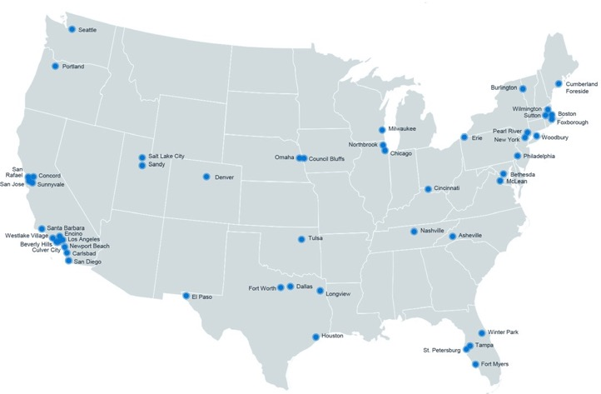
Retirement & Private Wealth Services
We help you get ready for tomorrow
Who We Serve
HUB International
By the
Numbers
When you work with us, you’re at the center of a vast network of retirement, wealth management, and financial wellness specialists ready to bring clarity to a changing world with tailored solutions and unrelenting advocacy.
Organizations
For-Profit companies, Not-for-profit organizations and governmental entities
National Reach | Local Leadership
530+
Locations in
North America
Individuals and Families
Mass affluent and high net worth individuals and families
Employees
Workforce and executives
Top 5*
Global Insurance Broker
Austin
Main TCG Office
Advisory
$172B+
Retirement plan assets under advisement
Retirement Plans
10,000
Retirement plans under advisement
17,000+
Employees
*Source: https://bit.ly/21K26Zs
Insurance services are offered through HUB International, an affiliate.
*HUB International Limited (“HUB”) owned RIAs provide investment advisory and management services to its respective clients, under the general trade name of HUB Retirement and Private Wealth. All current HUB RIAs maintain a combined total of $172,292,249,664 in aggregated regulatory assets under management (“Aggregated AUM”), based on the reported AUM for each respective individual HUB RIA effective as of December 31, 2023. The AUM for each individual HUB RIA may be found in the respective Form ADV for each respective HUB RIA. This Aggregated AUM for all HUB RIAs are broken out as follows: $109,326,671,524 in nondiscretionary institutional AUM; which AUM primarily represents qualified retirement plan assets (both ERISA and non-ERISA plans), non-qualified plan assets, and other types of institutional assets. $33,455,679,298 in discretionary institutional AUM; which AUM primarily represents qualified retirement plan assets (both ERISA and non-ERISA plans), non-qualified plan assets, and other types of institutional assets. $29,509,868,842 in Private Wealth Client AUM; which is a combination of both discretionary and non-discretionary AUM.

Slide 3
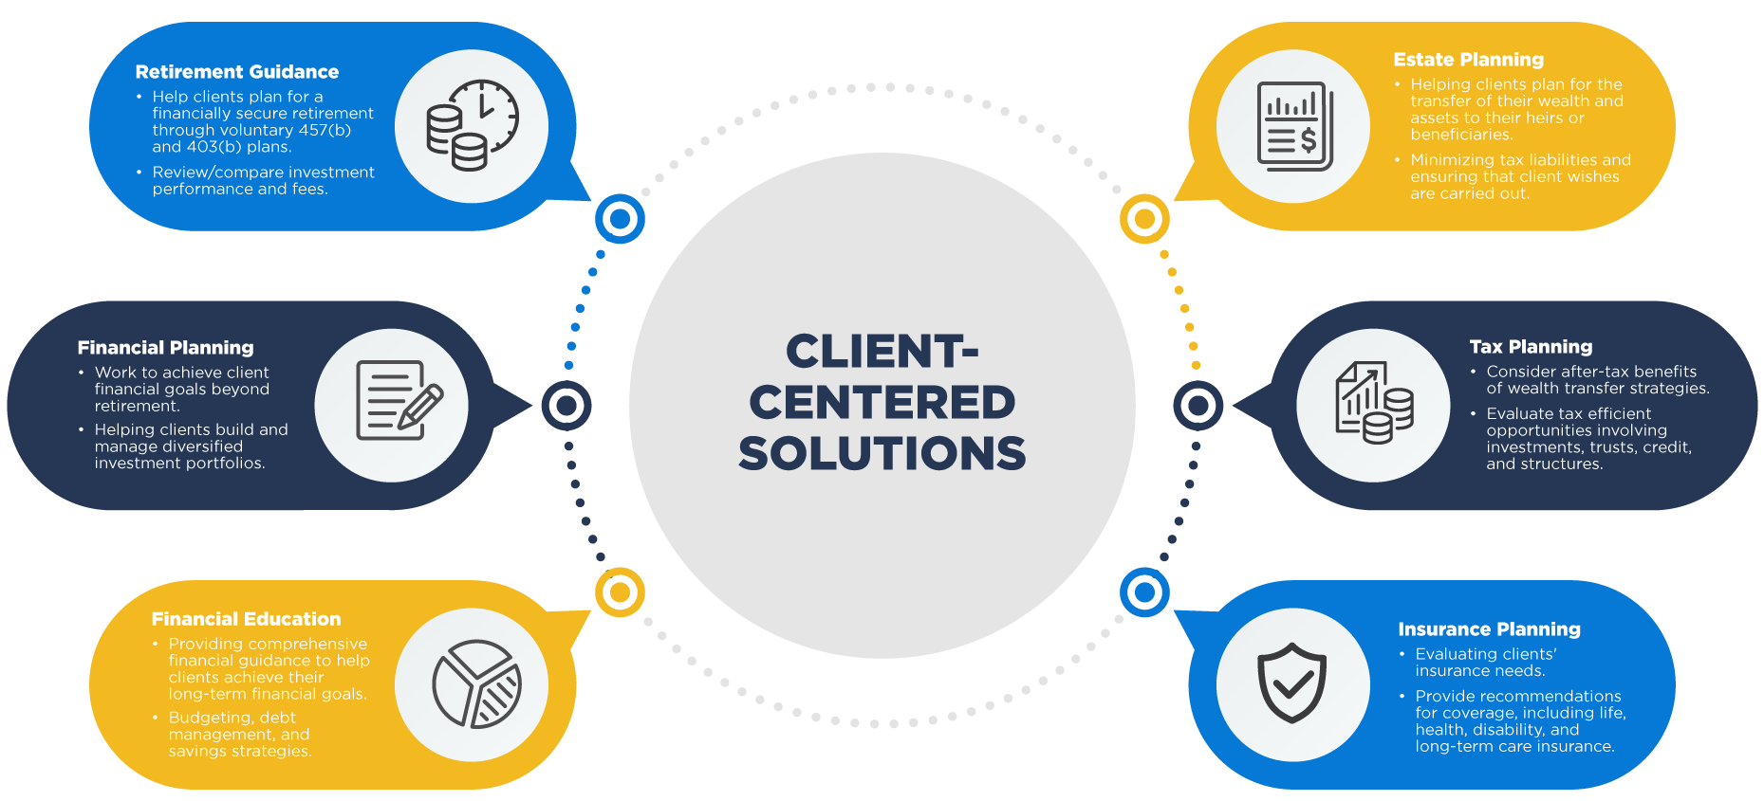

Slide 4
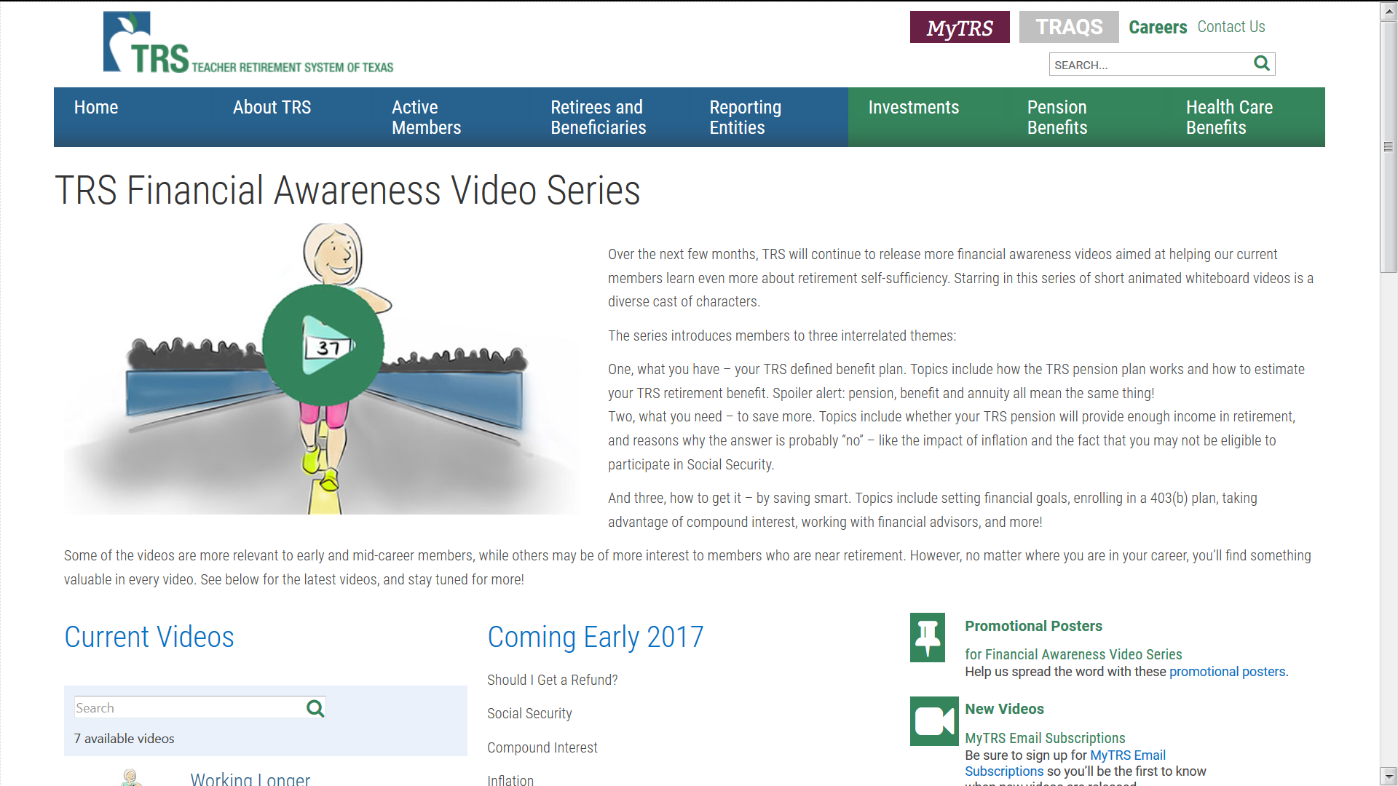
But… Can You Afford to Retire?

Slide 5
Factors to consider before you retire
Inflation
Life Expectancy
Expenses
Make a retirement budget and live off it for 3 months before you retire
Savings
Healthcare

Slide 6
TRS Options

Slide 7
TRS Annuity Options
Standard Annuity
Maximum benefit for retiree’s life only

Slide 8
TRS Annuity Options
OPTION 1
100% Joint Survivor
OPTION 2
50% Joint Survivor
OPTION 3
60 Month Period Certain
OPTION 4
120 Month Period Certain
OPTION 5
75% Joint Survivor
Reduced annuity, payable for retiree’s life with continuous payments for beneficiary’s life. If beneficiary pre-deceases, retiree’s annuity is increased to standard annuity amount
Most common, typically 8-13% reduction from Standard Annuity
Reductions range from 4-8% based on same age beneficiary
Reduced annuity, payable for retiree’s life with annuity payments guaranteed for a minimum of 60 months
If retiree dies before 60th payment, beneficiary will receive the remaining payments
Typically 1-2% reduction from Standard Annuity
Typically 1-4% reduction from Standard Annuity
Reductions range from 6-12% based on same age beneficiary
Remember all investing involves risk and past performance is not a guarantee of future returns.

Slide 9
Death Benefits

Slide 10
Risky Decisions
The beneficiary is grieving and may not make good financial decisions
The law requires TRS to present a number of options, some of which are almost always bad financially
The individual who qualifies for a lifetime annuity (worth potentially hundreds of thousands of dollars) may be tempted to take a lump sum worth much less in the long run

Slide 11
TRS Death Benefits – One of these Options
Must have active TRS service in year Member dies
Receive One of the following Options
Greater of:
2 x annual rate of compensation for the school year of death; or
2 x creditable compensation in the preceding school year
Up to maximum of $80,000
With 5 or More Years of Service:
60 monthly payments equal to your standard annuity without reduction for age; OR
Option 1 Lifetime Annuity as of the month prior to Death

Slide 12
TRS Death Benefits – One of these Options
An amount equal to the accumulated Member contributions in TRS account
$2,500 lump sum payment plus a monthly payment:
To a beneficiary spouse, $250 per month for life beginning at later of spouse reaching age 65 or the Member's death
To a beneficiary spouse who has one or more minor children, $350 per month, continuing until the youngest child reaches age 18. At age 65, the beneficiary spouse would again begin receiving $250 per month for life
To minor children beneficiaries, $350 per month with two or more children less than age 18, or $250 per month with only one child under age 18
To a dependent parent beneficiary, $250 per month for life at the later of when the dependent parent reaches age 65 or the Member’s death

Slide 13
TRS Death Benefits – One of these Options
Additional $160,000 if die due to physical assault in job
If not active member, still receive benefits listed if
Member’s death occurs during a time when they were eligible to retire or would become eligible to retire without further service before the 5th anniversary of their last day of service as a member;
Member’s absence from service was because of sickness, accident, or other cause TRS determines involuntary
Member’s absence from service was in furtherance of the objectives or welfare of the public school system; or
Member’s death occurred on or after Jan. 1, 2007, while performing qualified military service
If do not meet any of these then the beneficiary of a TRS Member is entitled to a return of the Member’s accumulated contributions

Slide 14
TRS Disability

Slide 15
TRS Disability Benefits
Conditions to Receive TRS Disability
Member is mentally or physically disabled from the further performance of their job duty;
The disability is probably permanent; and
The TRS Medical Board certifies the disability
May have to be recertified annually
Amount of Payments
10 Years of Service or more
Lifetime Standard Annuity unreduced for early age retirement
(Years of Service X 2.3% X Final Average Salary at disability)
Minimum $150 per month
Can pick other TRS annuity options but disability actuarial factors apply
Cannot later elect a service retirement

Slide 16
TRS Disability Benefits
Amount of Payments
Fewer than 10 Years of Service
Minimum $150 per month
Time Period Paid — Lesser of:
Number of months covered by (worked under) TRS
12 months for every year of service (months in partial years are also counted)
Duration of disability
Duration of life
If return to work after disability, years of service prior to disability may not be counted in later service retirement (must check with TRS to see)

Slide 17
TRS Care

Slide 18
TRS-Care
Eligibility
Cannot be eligible for ERS, UT, or A&M System health benefit coverage
Must take TRS retirement and have at least 10 years service credits; and either
Up to 5 years of military service credit
Rule of 80
30 or more years of service

Slide 19
Electing TRS-Care
TRS Retirement Division will first approve your application to retire, then send the approval to TRS Care
TRS Care will then send you the forms to request TRS Care
A good rule: Always elect TRS-Care for you and your spouse if you are eligible
You can cancel later
If you will be covered by other health care you can waive TRS-Care and will be allowed back in later—but only have a 30-day window to do so if your other coverage ends
Submit form to TRS within 90 days of your retirement date

Slide 20
TRS Care
Before Age 65
High deductible plan
You must budget for the cost of your healthcare – no copays for Doctors and most drugs (an exception is made for some life-saving drugs)
For most participants, you will have significant healthcare costs
2025 Plan Highlights
Deductibles
In-Network $1,650 individual plan; $3,300 family plan
Out-of-Network $3,300 individual plan; $6,600 family plan
Maximum out-of-pocket
In-Network $5,650 individual plan; $11,300 family plan
Out-of-Network $11,300 individual plan; $22,600 family plan

Slide 21
TRS Care
Age 65 and after
Medicare Advantage Plan
Much lower out-of-pocket costs than pre-age 65
Important Points
You must enroll in Medicare A and B before your TRS Care changes to the Advantage Plan
All U.S. Citizens qualify for Medicare – but you may have to pay for it
Medicare A is free if you or your spouse have paid enough years of FICA/Medicare Tax; if not, cost is low
Medicare B always has a cost – based on your income
Your cost for premiums will be TRS Care + Medicare

Slide 22
TRS Care
Strongly consider TRS Medicare Advantage Plan vs. private plans
Premiums are subsidized by State and likely to be for your lifetime
Open PPO – you can use any medical facility or Doctor that accepts Medicare
Once you are in a Medicare Advantage Plan it can be difficult to change to another provider or go back to Medicare alone or with a Supplement
Claims filing is much easier – everything though one provider vs. regular Medicare accompanied by Medicare Supplements (for costs not covered and drugs)
If you do not choose TRS Care you can lose your ability to re-enroll later on an irrevocable basis

Slide 23
Caution
TRS Care is dependent on the Texas Legislature
It could be repealed – HB 430 – Rep. Ken King (Panhandle district – Canadian)
Contact your State Representatives and Senators to oppose this!
If repealed what could happen?
Below age 65 - “Deep Doo Doo”
Will be difficult to get healthcare coverage but not impossible
Consider using a reputable health insurance broker – check references and experience
Got to Affordable Care Act contacts – under Biden Administrations these will be more abundant
Age 65 +
Will use Medicare and need to select a Medicare Advantage Plan or Medicare Supplement
Medicare website is excellent resource
Consider using a reputable health insurance broker – check references and experience

Slide 24
TRS Care
Excellent material on TRS Website
Plan Highlights and Premiums:
https://www.trs.texas.gov/TRS%20Documents/trs-care-2023-plan-highlights.pdf
For those age 65 or over, comparison of TRS Care to other coverage:
https://www.trs.texas.gov/TRS%20Documents/health_care_info_session_medicare_flyer.pdf

Slide 25
Medicare
Notes:
The next thing we’re going to talk about is Medicare.

Slide 26
Medicare
Part A (Hospital Insurance)
Pays for most basic hospital care and follow-up and some outpatient services
No premium
Part B (Medical Insurance)
Helps pay most outpatient treatment
Monthly premium deducted from Social Security
Medicare is the nation’s largest health insurance program, which covered more than 63.9 million Americans in 2021.
Sources: Medicare Fact Sheet, 2022; Medicare & You Handbook 2023 (https://www.medicare.gov/Pubs/pdf/10050-medicare-and-you.pdf)
Notes:
Medicare is a federal government program that helps older and some disabled Americans obtain and pay for medical care. Administered by the U.S. Department of Health and Human Services, Medicare is the nation’s largest health insurance program, which covered more than 63.9 million Americans in 2021.*
The program is divided into two components: Part A and Part B.
Part A is called hospital insurance and covers most of the costs of a stay in the hospital, as well as some follow-up costs after time in the hospital. Part A pays some other outpatient medical services, including some home health care. It covers none of the cost of prescription drugs. Under most circumstances, you do not have to pay a premium for Part A.
Part B is medical insurance. This optional coverage is intended to help pay doctor’s bills for treatment in or out of the hospital. It also covers many other medical expenses you incur when you are not in the hospital, such as the costs of necessary medical equipment and tests. If you elect Part B, a monthly premium is automatically deducted from your Social Security check.
For more information about Medicare Part A and Part B, see the handout.
Sources: Medicare Fact Sheet, 2022; Medicare & You Handbook 2023 (https://www.medicare.gov/Pubs/pdf/10050-medicare-and-you.pdf)

Slide 27
Medicare Options
Original Medicare Plan
Medicare Advantage
Call (800) 633-4227 or log on to www.medicare.gov
Source: Medicare & You Handbook 2023 (https://www.medicare.gov/Pubs/pdf/10050-medicare-and-you.pdf)
Notes:
You have two options for Medicare coverage: the Original Medicare Plan and Medicare Advantage, a managed care plan. Each of these programs has pros and cons.
With the Original Medicare Plan, you pay your Part B monthly premium and then pay for additional services as you use them. In 2023, the standard monthly premium is $164.90. Additionally, the Medicare Part B deductible is $233.00 in 2023.*
If your modified adjusted gross income as reported on your IRS tax return from 2 years ago (the most recent tax return information provided to Social Security by the IRS) is above a certain amount, you may pay more.
Medicare Advantage, an optional program available through private insurance companies, provides HMO-type coverage.
To determine which program is right for your needs, call 1-800-MEDICARE (633-4227) or log on to www.medicare.gov.
*Source: www.cmse.gov.

Slide 28
Other Insurances

Slide 29
Insurance Protection
Insurance Needs | Near Retirement | 5+ Years
Disability Protection | Need Decreases if Vested in TRS | Group Policy — Very important
Life Insurance | TERM — Decreasing Need, Analyze TRS Annuity Options | GROUP/INDV TERM Income Replacement, College Funding, Goals
Umbrella Coverage | YES | YES

Slide 30
Long-Term Care Insurance
Paying for 2 Households?
Trend has moved from Nursing Home to In-Home care
Can be a Tremendous Drain on Assets
Insurance is a Transfer of Risk
Only purchase what you need
Avoid “Cadillac” policies
Do your research — new types of policies

Slide 31
Become educated
Consult handbook, online tools & videos or visit counselor
Contact TRS 6 months prior to retirement date to submit a request for an estimate and packet
TRS Form 18
Verify & complete any service purchase options
Retirement Checklist

Slide 32
Complete documents and submit copies of birth records for you and beneficiary
TRS Form 30
Retirement Date
Payment Options
Beneficiary Designation
Retirement Checklist

Slide 33
Evaluate TRS-Care Options
Terminate employment by effective date
Collect Pension
1st payment is due the 1st business day of the month following first calendar month of retirement
Example: May 31st retirement, June wait, July 1st (or first business day) check arrives.
Retirement Checklist

Slide 34
We’re here to help! Book a Personalized Retirement Planning Session
Get started at: www.tcgservices.com/telewealth
Scan QR code

Slide 35
Contact Us
512-600-5200
advisors@tcgservices.com
900 S Capital of Texas Hwy, Suite 350
Austin, TX 78746
www.tcgservices.com/telewealth

Slide 36
Important Disclosures
Investment advisory services offered through TCG Advisors, an SEC registered investment advisor. Insurance Services offered through HUB International. Recordkeeper and Third Party Administrator services offered through TCG Administrators, a HUB International Company. FinPath is offered through RPW Solutions.
HUB International, owns and operates several other entities which provide various services to employers and individuals across the U.S.
Employees of HUB International may offer securities through partner Broker Dealers not affiliated with HUB. Employees of HUB International provide advisory services through both affiliated and unaffiliated Registered Investment Advisors (RIA). Global Retirement Partners, LLC, HUB Investment Advisors, TCG Advisors, Millennium Advisory Services, and Sheridan Road Advisors, LLC are wholly owned subsidiaries of HUB International.
This presentation is not authorized for use as an offer of sale or a solicitation of an offer to purchase investments in any of the plans discussed or an affiliated entity. An investment in the plans carries the potential for loss. This presentation is for informational purposes only and does not constitute an offer to sell, a solicitation to buy, or a recommendation for any security, or as an offer to provide advisory or other services in any jurisdiction in which such offer, solicitation, purchase or sale would be unlawful under the securities laws of such jurisdiction.
Past performance may not be indicative of any future results. No current or prospective client should assume that the future performance of any investment or investment strategy referenced directly or indirectly in this report will perform in the same manner in the future. Different types of investments and investment strategies involve varying degrees of risk—all investing involves risk—and may experience positive or negative growth. Nothing in this presentation should be construed as guaranteeing any investment performance.
An investment in the plans discussed will involve a significant degree of risk, and there can be no assurance that the investment objectives will be achieved or that an investment therein will be profitable. The hypothetical performance presented herein reflects the reinvestment of dividends and other earnings, the deduction of all management fees, performance-based allocations, brokerage fees and other expenses applicable to the Fund. Investors will experience individual returns that vary materially from those illustrated in this presentation depending on various factors, including but not limited to, the timing of their investment, the level of fees, and the effects of additions and withdrawals from their capital accounts. Certain of the performance information presented herein are unaudited estimates based upon the information available to the Firm as of the date hereof, and are subject to subsequent revision as a result of the Fund’s audit. Past performance is not necessarily indicative of the future performance or the profitability of an investment in a plan. An investment in a plan will be subject to a wide variety of risks and considerations as detailed in the offering documents. The information set forth herein will be qualified in its entirety by the information set forth in the offering documents.
This presentation includes forward-looking statements. All statements that are not historical facts are forward-looking statements, including any statements that relate to future market conditions, results, operations, strategies or other future conditions or developments and any statements regarding objectives, opportunities, positioning or prospects. Forward-looking statements are necessarily based upon speculation, expectations, estimates and assumptions that are inherently unreliable and subject to significant business, economic and competitive uncertainties and contingencies. Forward-looking statements are not a promise or guaranty about future events. TCG.36.2023

